Slide 1
Day04
[OOP]

Slide 2
Revision

Slide 3
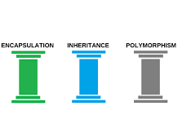
OOP Definition
OOP Consists Of 4 Pillars :
Encapsulation
Inheritance
Polymorphism
Abstraction

Slide 4
Struct

Slide 5
Struct
Point P1 ;
P1 = new Point(1,2);
Y
X
2
1
8 Bytes
Stack

Slide 6
Class

Slide 7
Class
What You Can Write Inside The Class
1. Attributes [Fields] => Member Variable
2. Functions [Constructor , Getter Setter , Method]
3. Properties [Full Property , Automatic Property , Indexer]
4. Events
C# Keywords Indicate The Accessibility Scope

Slide 8
Class
Access Modifier Allowed Inside Class?
Private [Default]
Private Protected
Protected
Internal
Protected Internal
Public
C# Keywords Indicate The Accessibility Scope

Slide 9
Class
Car C1;
C1 = new Car(10 , “BMW” , 290);
B M W
Speed
Model
Id
290
10
StringRef
C1
16
Bytes
Stack
Heap

Slide 10
Class
VS
Struct

Slide 11
Class VS Struct
Reference Type
Value Type
Support 4 Pillars Of OOP
Support Encapsulation and Overloading in Polymorphism
More Flexible
Does Support Inheritance
Doesn’t Support Inheritance
6 Access Modifier Allowed Inside It
3 Access Modifier Allowed Inside It
If You Defined a user defined Constructor , Compiler Will no longer Generate Empty Parameterless Constructor
If You Defined a user defined Constructor , Compiler Will always Generate Parameterless Constructor

Slide 12
Encapsulation
Separate Data Definition [Attributes] From Its Use [Getter Setter , Property]

Slide 13
OOP Definition
OOP Consists Of 4 Pillars :
Encapsulation
Inheritance
Polymorphism
Abstraction

Slide 14
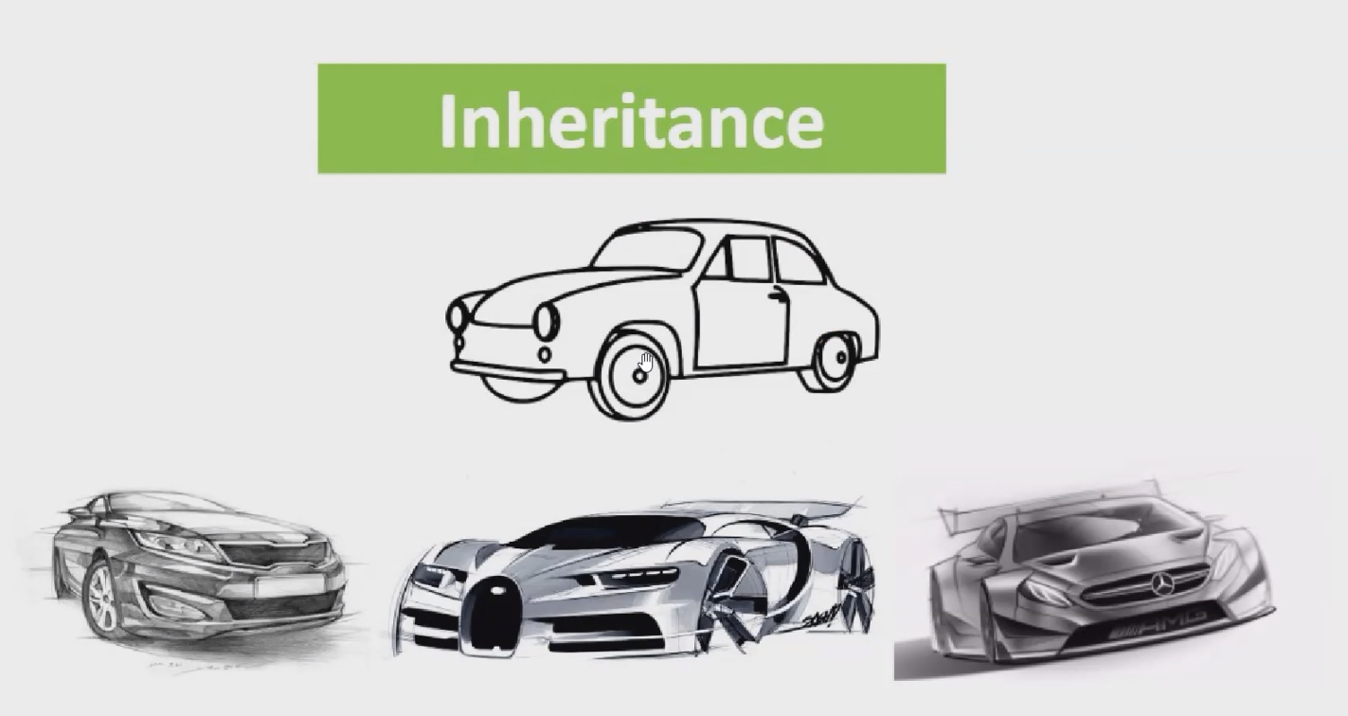

Slide 15
Interface
Code Contract Between Two Developers

Slide 16
Interface
What You Can Write Inside The Interface
Signature for Property
Signature for Method
Default Implemented Method
C# Keywords Indicate The Accessibility Scope

Slide 17
Interface
Default Access Modifier Inside Interface => Public
Default Access Modifier of Interface => Internal
Private Access Modifier is not allowed inside interface
You Can not Create an object from interface but you can create a reference from interface
Interface Can be Implemented Through Class Or Struct
C# Keywords Indicate The Accessibility Scope

Slide 18
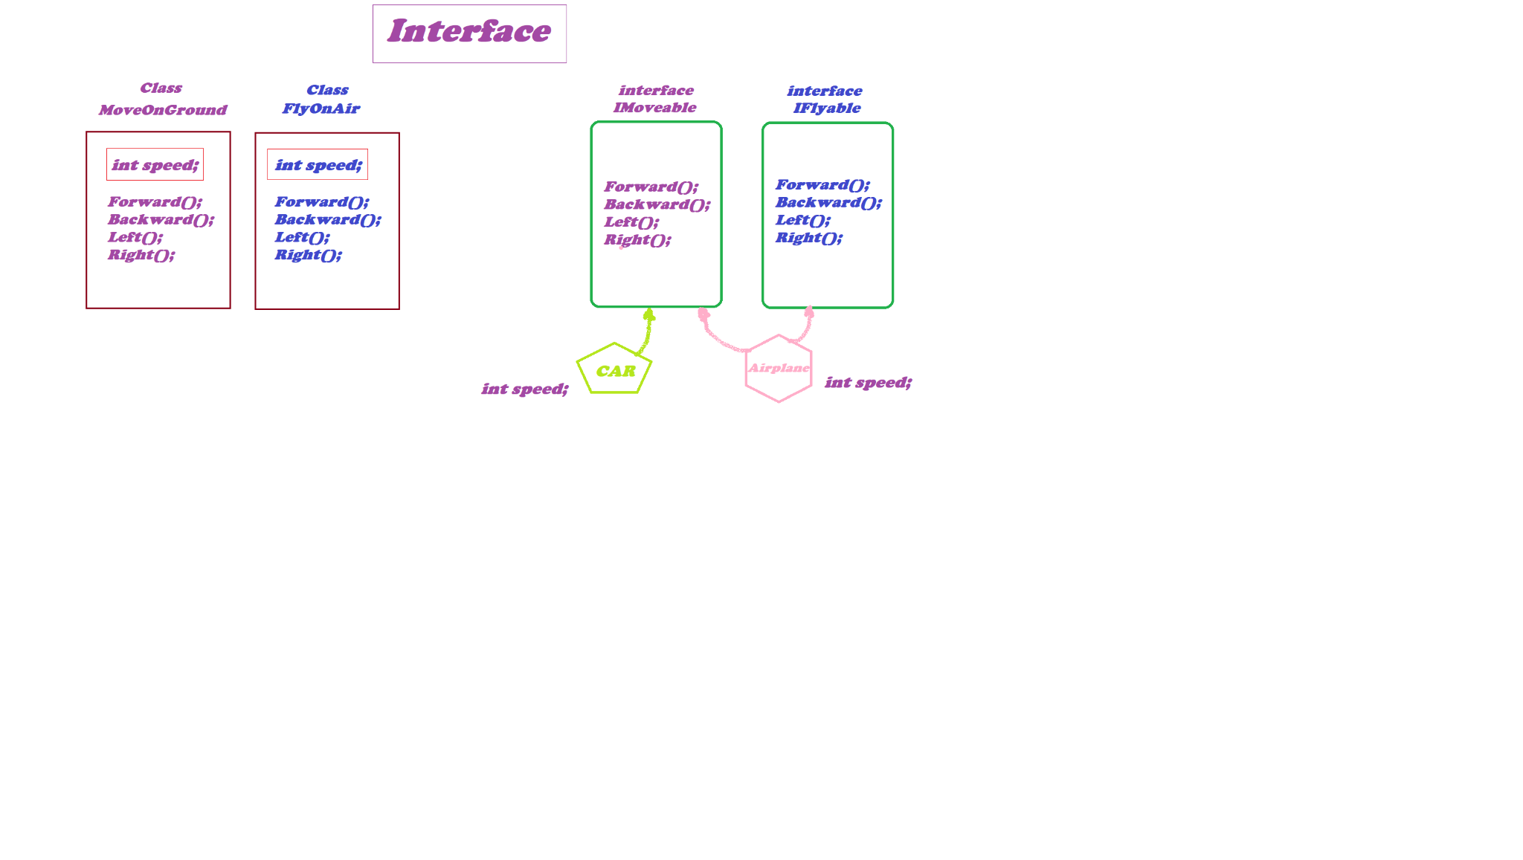
Interface
C# Keywords Indicate The Accessibility Scope

Slide 19
Interface
C# Keywords Indicate The Accessibility Scope

